Slide 1
Chapter 5: Process Synchronization

Slide 2
Chapter 5: Process Synchronization
Background
The Critical-Section Problem
Peterson’s Solution
Synchronization Hardware
Mutex Locks
Semaphores
Classic Problems of Synchronization
Monitors
Synchronization Examples
Alternative Approaches

Slide 3
Objectives
To present the concept of process synchronization.
To introduce the critical-section problem, whose solutions can be used to ensure the consistency of shared data
To present both software and hardware solutions of the critical-section problem
To examine several classical process-synchronization problems
To explore several tools that are used to solve process synchronization problems

Slide 4
Background
Processes can execute concurrently
  May be interrupted at any time, partially completing execution
Concurrent access to shared data may result in data inconsistency
Maintaining data consistency requires mechanisms to ensure the orderly execution of cooperating processes
Illustration of the problem:
Suppose that we wanted to provide a solution to the consumer-producer problem that fills all the buffers. We can do so by having an integer counter that keeps track of the number of full buffers. Initially, counter is set to 0. It is incremented by the producer after it produces a new buffer and is decremented by the consumer after it consumes a buffer.

Slide 5

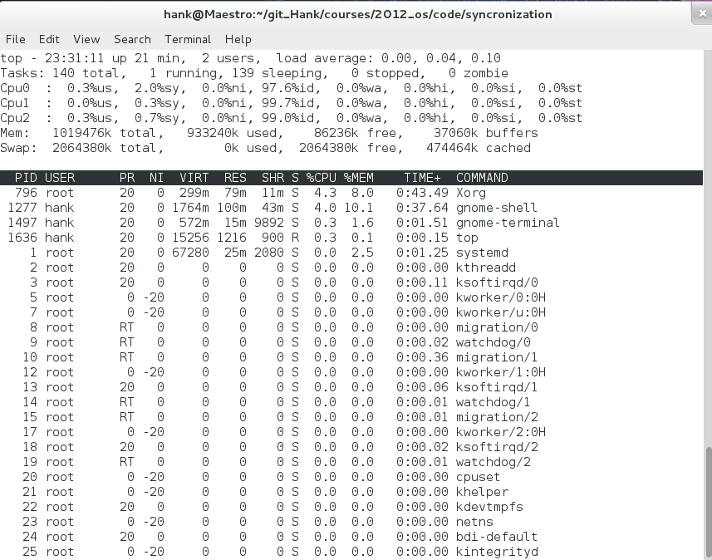
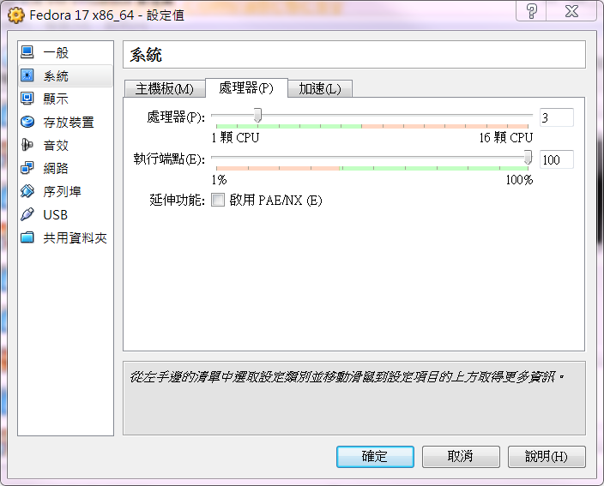
Synchronization
Type ‘1’ to toggle SMP view
Make sure your machine has multiple cores

Slide 6
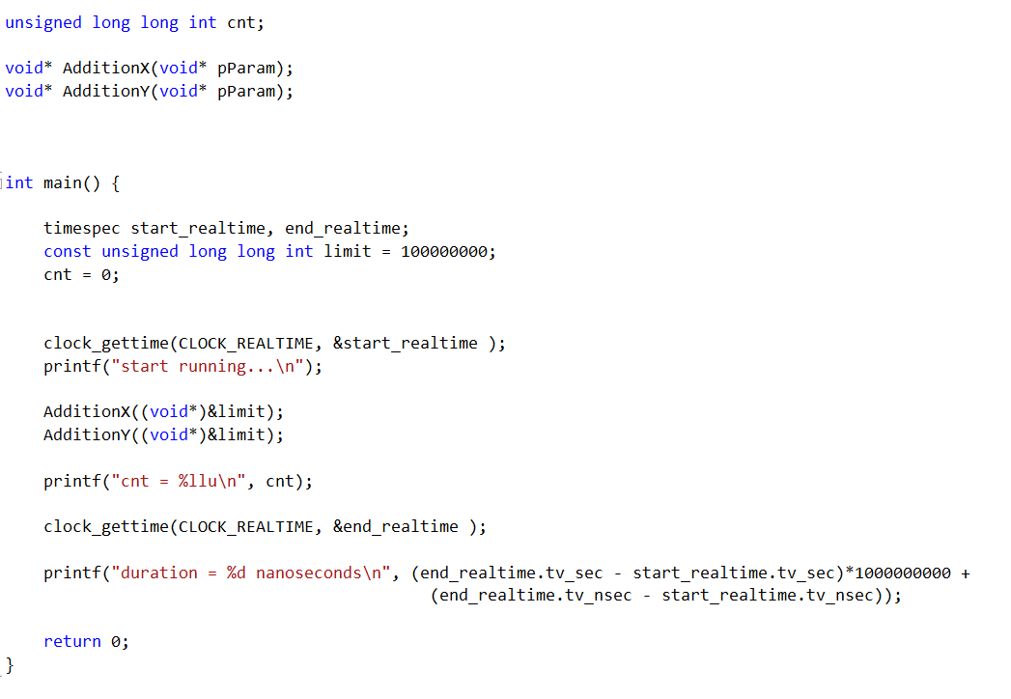
Single thread addition
Single_thread_add.cpp

Slide 7
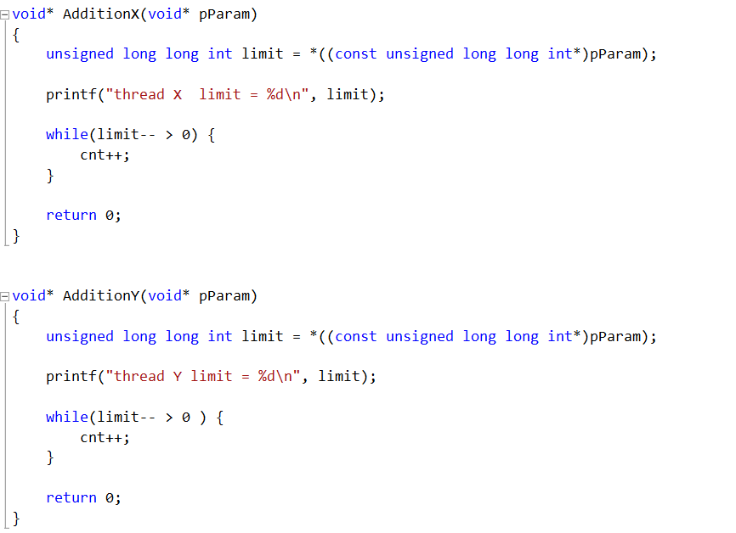
Single thread addition
Single_thread_add.cpp

Slide 8
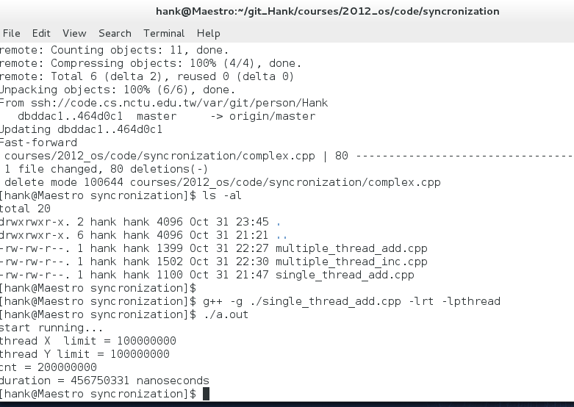
Single thread addition

Slide 9
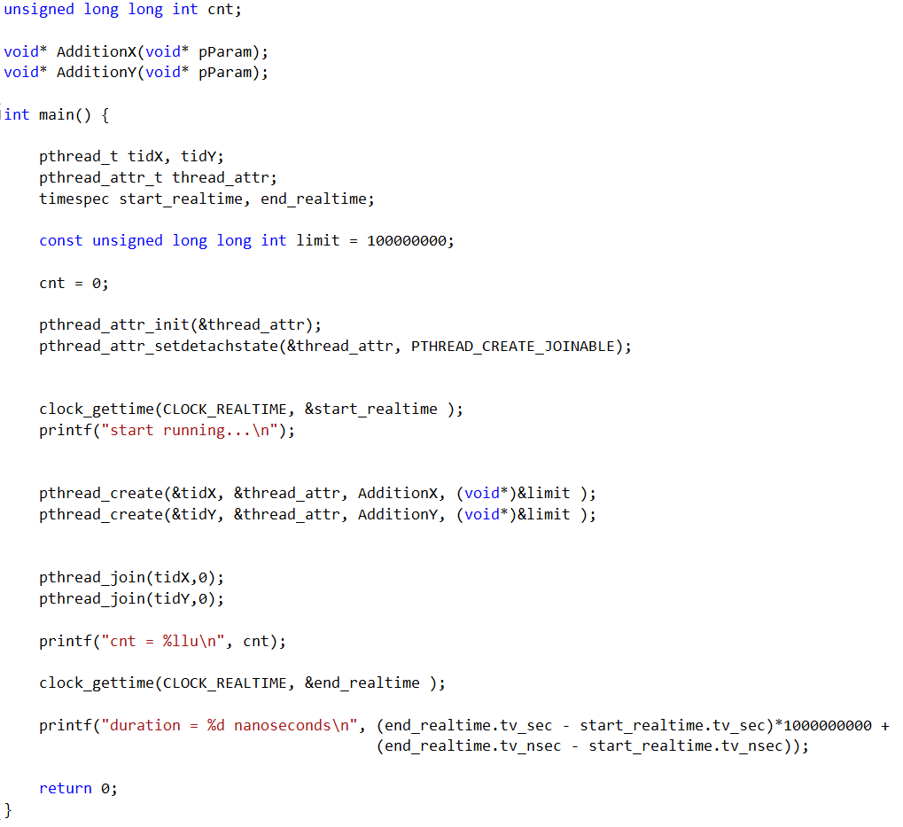
Multithread addition
multiple_thread_add.cpp

Slide 10
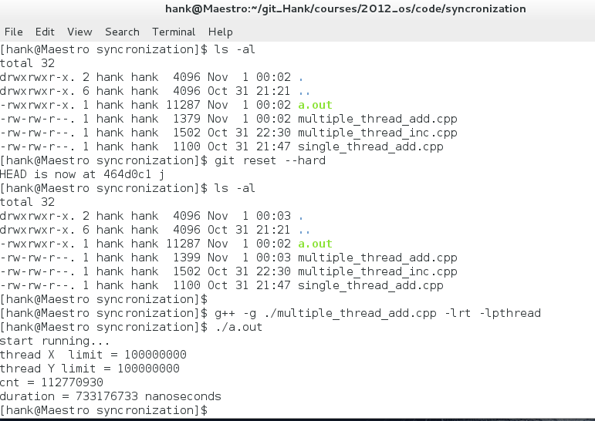
Multithread Addition
multiple_thread_add.cpp

Slide 11
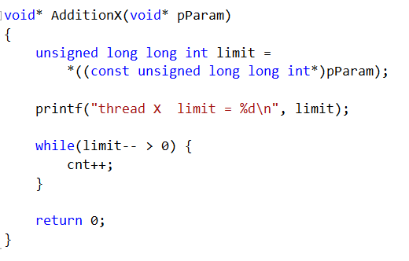
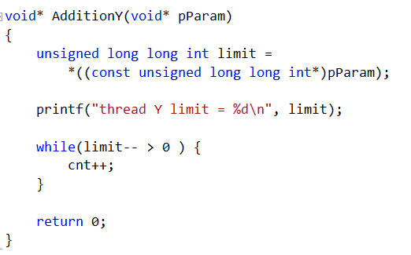
Multithread Addition
The code of AdditionX and the code of AdditionY may interleave
Any problem?
The code of AdditionX and the code of AdditionY may overlap
Any problem?

Slide 12
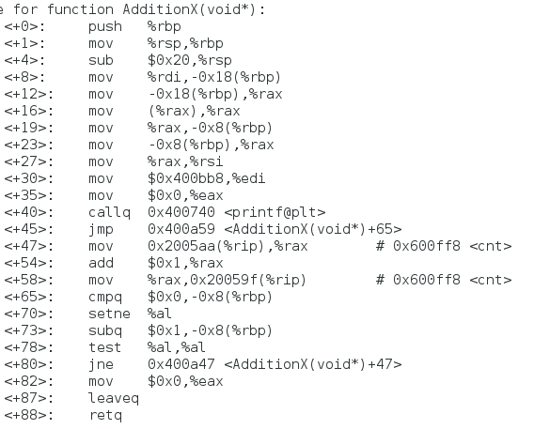
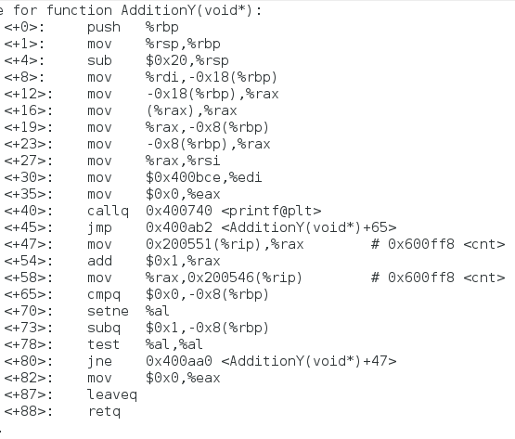
Multithread Addition
‘cnt++’ is compiled into multiple instructions

Slide 13
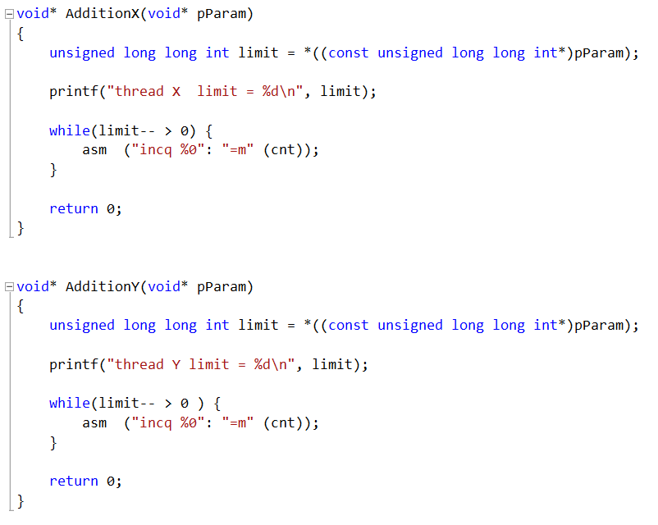
Multithread Inc
multiple_thread_inc.cpp
A single line of assembly
Will this version run correctly on a uniprocessor?
Will this version run correctly on a multiprocessor?

Slide 14
Producer
while (true) {
/* produce an item in next produced */
while (counter == BUFFER_SIZE) ;
/* do nothing */
buffer[in] = next_produced;
in = (in + 1) % BUFFER_SIZE;
counter++;
}

Slide 15
Consumer
while (true) {
while (counter == 0)
; /* do nothing */
next_consumed = buffer[out];
out = (out + 1) % BUFFER_SIZE;
counter--;
/* consume the item in next consumed */
}

Slide 16
Race Condition
counter++ could be implemented as
register1 = counter
register1 = register1 + 1
counter = register1
counter-- could be implemented as
register2 = counter
register2 = register2 - 1
counter = register2
Consider this execution interleaving with “count = 5” initially:
  S0: producer execute register1 = counter {register1 = 5}
  S1: producer execute register1 = register1 + 1 {register1 = 6}
  S2: consumer execute register2 = counter {register2 = 5}
  S3: consumer execute register2 = register2 – 1 {register2 = 4}
  S4: producer execute counter = register1 {counter = 6 }
  S5: consumer execute counter = register2 {counter = 4}

Slide 17
Critical Section
Producer thread
Consumer thread
while (true) {
/* produce an item and put in nextProduced */
while (count == BUFFER_SIZE ); // do nothing
buffer [in] = nextProduced;
in = (in + 1) % BUFFER_SIZE;
count++;
}
while (true) {
while (count == 0) ; // do nothing
nextConsumed = buffer[out];
out = (out + 1) % BUFFER_SIZE;
count--; /* consume the item in nextConsumed
}
Code in this “critical section” should not be interleaved or overlapped

Slide 18
Critical Section - How
CriticalSection cs;
Producer thread
Consumer thread
while (true) {
/* produce an item and put in nextProduced */
while (count == BUFFER_SIZE ); // do nothing
buffer [in] = nextProduced;
in = (in + 1) % BUFFER_SIZE;
cs.lock();
count++;
cs.unlock();
}
while (true) {
while (count == 0) ; // do nothing
nextConsumed = buffer[out];
out = (out + 1) % BUFFER_SIZE;
cs.lock();
count--; /* consume the item in nextConsumed
cs.unlock();
}

Slide 19
Critical Section Problem
Consider system of n processes {p₀, p₁, … p_{n-1}}
Each process has critical section segment of code
  Process may be changing common variables, updating table, writing file, etc
  When one process in critical section, no other may be in its critical section
Critical section problem is to design protocol to solve this
Each process must ask permission to enter critical section in entry section, may follow critical section with exit section, then remainder section

Slide 20

Critical Section
General structure of process P_{i}

Slide 21
Algorithm for Process P_{i}
do {
while (turn == j);
critical section
turn = j;
remainder section
} while (true);

Slide 22
Solution to Critical-Section Problem
1. Mutual Exclusion - If process P_{i} is executing in its critical section, then no other processes can be executing in their critical sections
2. Progress (Freedom from Deadlock ) - If no process is executing in its critical section and there exist some processes that wish to enter their critical section, then the selection of the processes that will enter the critical section next cannot be postponed indefinitely
3. Bounded Waiting (Freedom from Starvation) - A bound must exist on the number of times that other processes are allowed to enter their critical sections after a process has made a request to enter its critical section and before that request is granted
  Assume that each process executes at a nonzero speed
  No assumption concerning relative speed of the n processes
“Freedom from starvation” implies “freedom from deadlock”

Slide 23
Critical-Section Handling in OS
Two approaches depending on if kernel is preemptive or non- preemptive
  Preemptive – allows preemption of process when running in kernel mode
  Non-preemptive – runs until exits kernel mode, blocks, or voluntarily yields CPU
    Essentially free of race conditions in kernel mode

Slide 24
1st attempt on the design of a Critical Section Lock
class CriticalSectionLockOne
{
bool flag[2];
public:
void lock()
{
int i = ThreadID.get();
int j = 1-i;
flag[i] = true;
while(flag[j]) ; // wait
}
void unlock()
{
int i = ThreadID.get();
flag[i] = false;
}
};
Assume that the LOAD and STORE instructions are atomic; that is, cannot be interrupted.

Slide 25
1st attempt on the design of a Critical Section Lock
Does CriticalSectionLockOne satisfy
  mutual exclusion?
  freedom from deadlock?
  freedom from starvation?

Slide 26
1st attempt on the design of a Critical Section Lock
Does CriticalSectionLockOne satisfy
  mutual exclusion?
  freedom from deadlock?
  freedom from starvation?

Slide 27






1st attempt on the design of a Critical Section Lock
Proof of that CriticalSectionLockOne satisfies mutual exclusion
Assume thread A and B.
Let be the interval during which A executes the critical section for the j-th time.
Let be the interval during which B executes the critical section for the k-th time.
write_{A}(x=v) denotes the event in which A assigns value v to field x.
read_{A}(v==x) denotes the event in which A reads v from field x.
Suppose CriticalSectionLockOne does not satisfy mutual exclusion. Then there exist integers j and k such that and . Consider each thread’s last execution of the lock() method before entering its k-th (j-th) critical section.
Inspecting the code, we see that
write_{A}(flag[A]=true)→read_{A}(flag[B]==false) → (1)
write_{B}(flag[B]=true)→read_{B}(flag[A]==false) → (2)
read_{A}(flag[B]==false) →write_{B}(flag[B]=true) (3)
By transitivity of the precedence order, we have
write_{A}(flag[A]=true)→read_{A}(flag[B]==false) →
write_{B}(flag[B]=true)→read_{B}(flag[A]==false)
It follows that write_{A}(flag[A]=true)→read_{B}(flag[A]==false) without an intervening write to the flag[] array, a contradiction. □

Slide 28
1st attempt on the design of a Critical Section Lock
CriticalSectionLockOne deadlocks if write_{A}(flag[A]=true) and write_{B}(flag[B]=true) events occur before read_{A}(flag[B]) and read_{B}(flag[A]) events, then both threads wait forever.

Slide 29
2nd attempt on the design of a Critical Section Lock
class CriticalSectionLockTwo
{
int victim;
public:
void lock()
{
int i = ThreadID.get();
victim = i; // let the other go first
while(victim ==i) ; // wait
}
void unlock() {}
};
Exercise: prove that CriticalSectionLockTwo satisfies mutual exclusion.
But CriticalSectionLockTwo deadlocks if one thread runs completely before the other

Slide 30
Peterson’s Solution
Two process solution
Assume that the LOAD and STORE instructions are atomic; that is, cannot be interrupted.
The two processes share two variables:
  int victim;
  Boolean flag[2]
The variable victim indicates whose turn it is to wait.
The flag array is used to indicate if a process is ready to enter the critical section. flag[i] = true implies that process P_{i} is ready!

Slide 31
Peterson Lock
class CriticalSection_PetersonLock
{
bool flag[2];
int victim;
public:
void lock()
{
int i = ThreadID.get();
int j = 1-i;
flag[i] = true; // I’m ready
victim = i; // you go first
while(flag[j] && victim==i) ; // wait
}
void unlock()
{
int i = ThreadID.get();
flag[i] = false; // I’m not ready
}
};

Slide 32
PetersonLock satisfies mutual exclusion
Suppose not. Consider the last execution of the lock method() by threads A and B. Inspecting the code, we see that
write_{A}(flag[A]=true) → write_{A}(victim=A) →
read_{A}(flag[B]) → read_{A}(victim) → (1)
write_{B}(flag[B]=true) → write_{B}(victim=B) →
read_{B}(flag[A]) → read_{B}(victim) → (2)
WLOG, assume that A was the last thread to write to the victim field
write_{B}(victim=B) →write_{A}(victim=A) (3)
Eq.(3) implies that A observed victim to be A in Eq. (1). Since A nevertheless entered its critical section, it must have observed flag[B] to be false, so we have
write_{A}(victim=A)→read_{A}(flag[B]==false) (4)
Eq.(2) ~ Eq.(4), together with the transitivity of precedence order, imply
write_{B}(flag[B]=true) → write_{B}(victim=B) →
write_{A}(victim=A) → read_{A}(flag[B]==false)
It follows that write_{B}(flag[B]=true) → read_{A}(flag[B]==false).
This is a contradiction because no other write to flag[B] was performed before the critical section executions. □

Slide 33
PetersonLock is starvation-free
Suppose not. WLOG, suppose that A runs forever in the lock() method. It must be executing the while statement, waiting until either flag[B] becomes false or victim is set to B.
What is B doing while A fails to make progress?
  Perhaps B is repeatedly entering and leaving its critical section. If so, however, then B sets victim to B as soon as it reenters the critical section. Once victim is set to B, it does not change, and A must eventually return from the lock() method(), a contradiction.
  So it must be that B is also stuck in the lock() method call, waiting until either flag[A] becomes false or victim is set to A. But victim cannot be both A and B, a contradiction. □

Slide 34
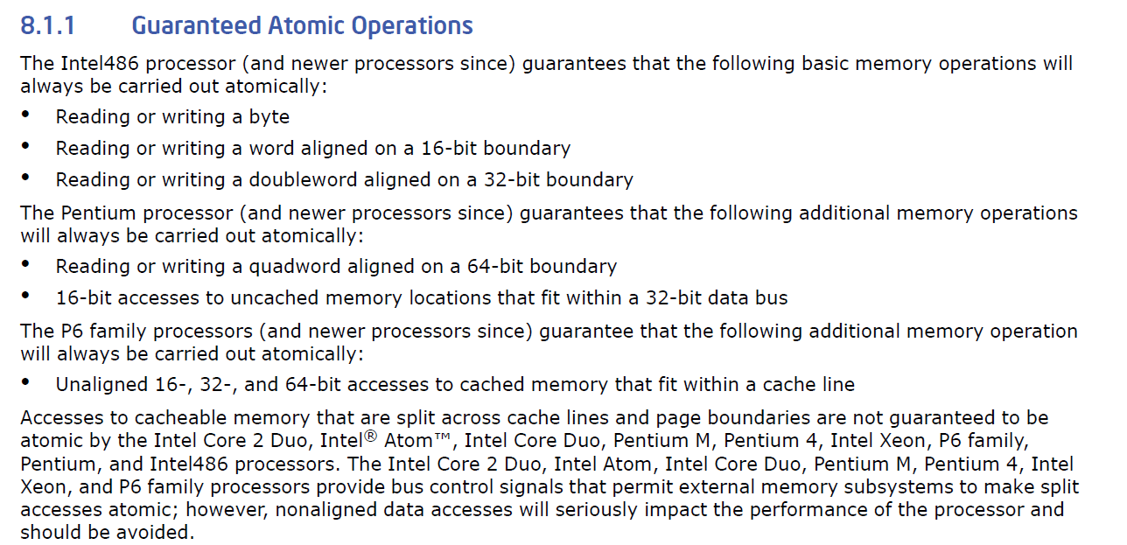
x86 Guaranteed Atomic Operations
Intel® 64 and IA-32 Architectures Software Developer's Manual_x000b_Volume 3A: System Programming Guide, Part 1

Slide 35
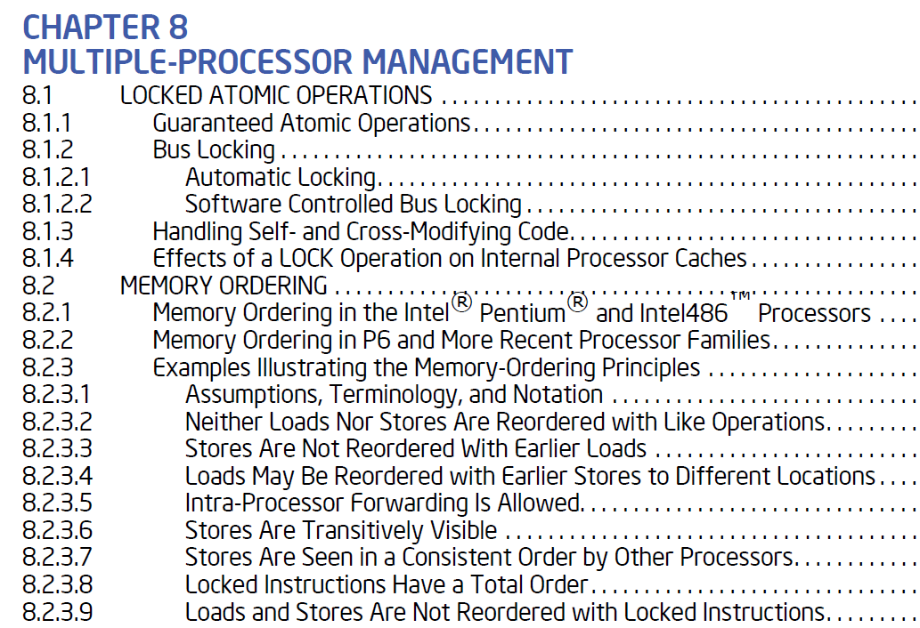
x86 memory ordering guarantees
Intel® 64 and IA-32 Architectures Software Developer's Manual_x000b_Volume 3A: System Programming Guide, Part 1

Slide 36
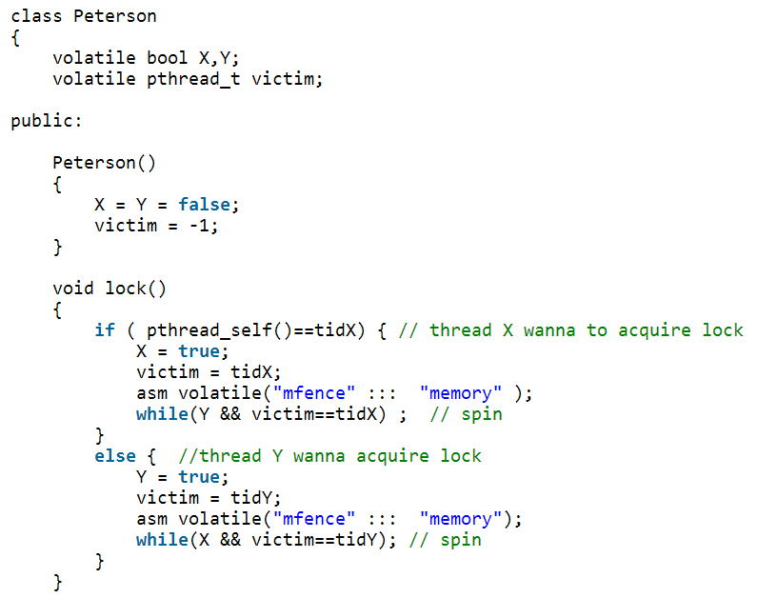
Peterson Lock in action
multithread_add_peterson.html
Prevent instruction reordering by processor
Prevent instruction reordering by optimizing compiler

Slide 37
Synchronization Hardware
Many systems provide hardware support for critical section code
Uniprocessors – could disable interrupts
  Currently running code would execute without preemption
  Generally too inefficient on multiprocessor systems
    Operating systems using this not broadly scalable
Modern machines provide special atomic hardware instructions
    Atomic = non-interruptable
  Either test memory word and set value
  Or swap contents of two memory words
  http://en.wikipedia.org/wiki/Read-modify-write
void lock()
{
  asm(“cli”); // disable interrupt
}
void unlock()
{
  asm(“sti”); // enable interrupt
}

Slide 38
Solution to Critical-section Problem Using Locks
do {
acquire lock
critical section
release lock
remainder section
} while (TRUE);

Slide 39
test_and_set Instruction
Definition:
boolean test_and_set (boolean *target)
{
boolean rv = *target;
*target = TRUE;
return rv:
}
Executed atomically
Returns the original value of passed parameter
Set the new value of passed parameter to “TRUE”.

Slide 40
Solution using test_and_set()
Shared Boolean variable lock, initialized to FALSE
Solution:
do {
while (test_and_set(&lock))
; /* do nothing */
/* critical section */
lock = false;
/* remainder section */
} while (true);

Slide 41
compare_and_swap Instruction
Definition:
int compare _and_swap(int *value, int expected, int new_value) {
int temp = *value;
if (*value == expected)
*value = new_value;
return temp;
}
Executed atomically
Returns the original value of passed parameter “value”
Set the variable “value” the value of the passed parameter “new_value” but only if “value” ==“expected”. That is, the swap takes place only under this condition.

Slide 42
Solution using compare_and_swap
Shared integer “lock” initialized to 0;
Solution:
do {
while (compare_and_swap(&lock, 0, 1) != 0)
; /* do nothing */
/* critical section */
lock = 0;
/* remainder section */
} while (true);

Slide 43
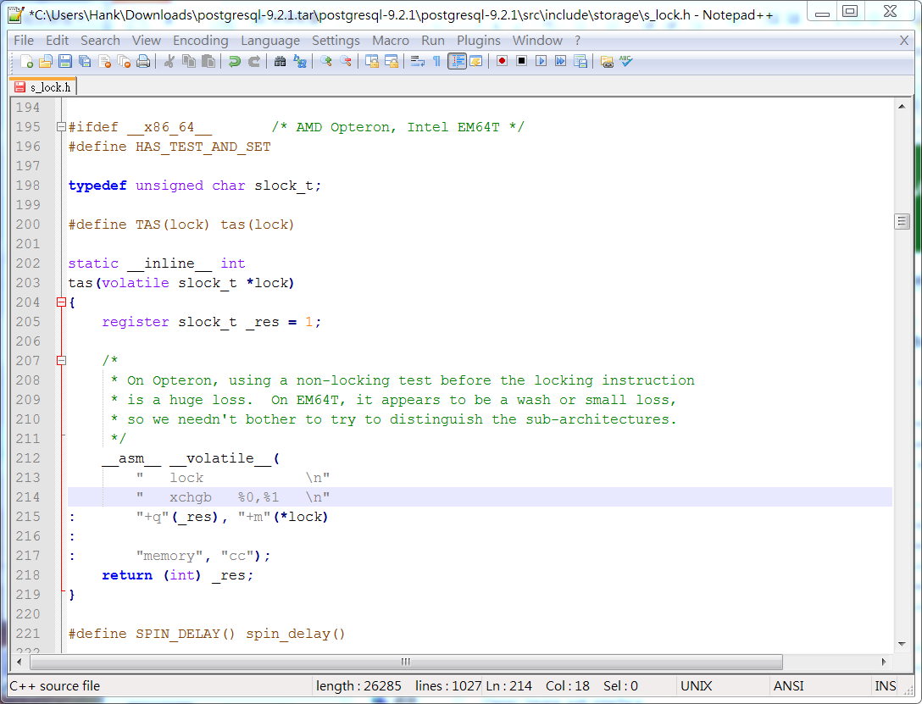
xchg (swap) on x86

Slide 44
Bounded-waiting Mutual Exclusion with TestandSet()
do {
waiting[i] = TRUE;
key = TRUE;
while (waiting[i] && key)
key = TestAndSet(&lock);
waiting[i] = FALSE;
// critical section
j = (i + 1) % n;
while ((j != i) && !waiting[j])
j = (j + 1) % n;
if (j == i)
lock = FALSE;
else
waiting[j] = FALSE;
// remainder section
} while (TRUE);
Wait until released or no one busy.
Look for a waiting process.
No process waiting.
Process j is waiting. Release it.

Slide 45
Mutex Locks
Previous solutions are complicated and generally inaccessible to application programmers
OS designers build software tools to solve critical section problem
Simplest is mutex lock
Protect a critical section by first acquire() a lock then release() the lock
  Boolean variable indicating if lock is available or not
Calls to acquire() and release() must be atomic
  Usually implemented via hardware atomic instructions
But this solution requires busy waiting
  This lock therefore called a spinlock

Slide 46
acquire() and release()
acquire() {
while (!available)
; /* busy wait */
available = false;;
}
release() {
available = true;
}
do {
acquire lock
critical section
release lock
remainder section
} while (true);

Slide 47
Semaphore
Synchronization tool that provides more sophisticated ways (than Mutex locks) for process to synchronize their activities.
Semaphore S – integer variable
Invented by Edsger Dijkstra in 1965
Can only be accessed via two indivisible (atomic) operations
  wait() and signal()
    Originally called P() and V()
Definition of the wait() operation
  wait(S) {
  while (S <= 0)
  ; // busy wait
  S--;
  }
Definition of the signal() operation
  signal(S) {
  S++;
  }

Slide 48
Semaphore Usage
Counting semaphore – integer value can range over an unrestricted domain
Binary semaphore – integer value can range only between 0 and 1
  Same as a mutex lock
Can solve various synchronization problems
Consider P₁ and P₂ that require S₁ to happen before S₂
Create a semaphore “synch” initialized to 0
  P1:
  S₁;
  signal(synch);
  P2:
  wait(synch);
  S₂;
Can implement a counting semaphore S as a binary semaphore

Slide 49
Semaphore Implementation
Must guarantee that no two processes can execute the wait() and signal() on the same semaphore at the same time
Thus, the implementation becomes the critical section problem where the wait and signal code are placed in the critical section
  Could now have busy waiting in critical section implementation
    But implementation code is short
    Little busy waiting if critical section rarely occupied
Note that applications may spend lots of time in critical sections and therefore this is not a good solution

Slide 50
Semaphore Implementation
Implementation of wait and signal
  wait (S) {
  while S <= 0
  yield(); // give up CPU time slices
  S--;
  }
  signal (S) {
  S++;
  }
Both methods are atomic
  The execution of wait(S) cannot be interrupted by other executions of wait(S) or executions of signal(S)
  The execution of signal(S) cannot be interrupted by other executions of wait(S) or executions of signal(S)
  Interrupts can occur during executions of wait(S) and signal(S) (preemptive scheduling still works !)
Notes:
Let us now consider the case where there are many threads (say
100) contending for a lock repeatedly. In this case, if one thread acquires
the lock and is preempted before releasing it, the other 99 will
each call lock(), find the lock held, and yield the CPU. Assuming
some kind of round-robin scheduler, each of the 99 will execute this
run-and-yield pattern before the thread holding the lock gets to run
again. While better than our spinning approach (which would waste
99 time slices spinning), this approach is still costly; the cost of a context
switch can be substantial, and there is thus plenty of waste.
Worse, we have not tackled the starvation problem at all. A thread
may get caught in an endless yield loop while other threads repeatedly
enter and exit the critical section. We clearly will need an approach
that addresses this problem directly.

Slide 51
Semaphore Implementation
With each semaphore there is an associated waiting queue. Each entry in a waiting queue has two data items:
  value (of type integer)
  pointer to next record in the list
Two operations:
  block – place the process invoking the operation on the appropriate waiting queue.
  wakeup – remove one of processes in the waiting queue and place it in the scheduler ready queue.

Slide 52
Semaphore Implementation
The implementation is correct only if the two methods are atomic !
Implementation of wait:
wait(semaphore *S) {
S->value--;
if (S->value < 0) {
add this process to S->list;
block();
}
}
Implementation of signal:
signal(semaphore *S) {
S->value++;
if (S->value <= 0) {
remove a process P from S->list;
wakeup(P);
}
}
How to ensure atomicity?

Slide 53
typedef struct __lock_t {
int flag;
int guard;
queue_t *q;
} lock_t;
void lock_init(lock_t *m) {
m->flag = 0;
m->guard = 0;
queue_init(m->q);
}
void lock(lock_t *m) {
while (TestAndSet(&m->guard, 1) == 1) ; //acquire guard lock by spinning
if (m->flag == 0) {
m->flag = 1; // lock is acquired
m->guard = 0;
} else {
queue_add(m->q, gettid());
m->guard = 0;
block();
}
}
void unlock(lock_t *m) {
while (TestAndSet(&m->guard, 1) == 1) ; //acquire guard lock by spinning
if (queue_empty(m->q))
m->flag = 0; // let go of lock; no one wants it
else
wakeup(queue_remove(m->q)); // hold lock (for next thread!)
m->guard = 0;
}
wakeup/waiting race
Notes:
What would happen if the release of the guard lock came
after the park(), and not before? Hint: something bad.
you might notice the perceived race condition in the solution,
just before the call to park(). With just the wrong timing,
a thread will be about to park, assuming that it should sleep until
the lock is no longer held. A switch at that time to another thread
(say, a thread holding the lock) could lead to trouble, for example,
if that thread then released the lock. The subsequent park by the
first thread would then sleep forever (potentially). This problem is
sometimes called the wakeup/waiting race; to avoid it, we need to
do some extra work
queue_add(m->q, gettid());
setblock(); // new code
m->guard = 0;
Block()

Slide 54
Deadlock and Starvation
Deadlock – two or more processes are waiting indefinitely for an event that can be caused by only one of the waiting processes
Let S and Q be two semaphores initialized to 1
P₀ P₁
wait(S); wait(Q);
wait(Q); wait(S);
... ...
signal(S); signal(Q);
signal(Q); signal(S);
Starvation – indefinite blocking
  A process may never be removed from the semaphore queue in which it is suspended
Priority Inversion – Scheduling problem when lower-priority process holds a lock needed by higher-priority process
  Solved via priority-inheritance protocol

Slide 55
Classical Problems of Synchronization
Classical problems used to test newly-proposed synchronization schemes
  Bounded-Buffer Problem
  Readers and Writers Problem
  Dining-Philosophers Problem

Slide 56
Bounded-Buffer Problem
N buffers, each can hold one item
Semaphore full initialized to the value 0
Semaphore empty initialized to the value N.

Slide 57
Bounded Buffer Problem (Cont.)
The structure of the producer process
do {
// produce an item
wait (empty);
// add the item to the buffer
signal (full);
} while (TRUE);
The structure of the consumer process
do {
wait (full);
// remove an item from buffer
signal (empty);
// consume the item
} while (TRUE);

Slide 58
Bounded-Buffer Problem
N buffers, each can hold one item
Semaphore mutex initialized to the value 1
Semaphore full initialized to the value 0
Semaphore empty initialized to the value N.

Slide 59
Bounded Buffer Problem (Cont.)
The structure of the producer process
do {
// produce an item
wait (empty);
wait (mutex);
// add the item to the buffer
signal (mutex);
signal (full);
} while (TRUE);
The structure of the consumer process
do {
wait (full);
wait (mutex);
// remove an item from buffer
signal (mutex);
signal (empty);
// consume the item
} while (TRUE);

Slide 60
Readers-Writers Problem
A data set is shared among a number of concurrent processes
  Readers – only read the data set; they do not perform any updates
  Writers – can both read and write
Problem – allow multiple readers to read at the same time
  Only one single writer can access the shared data at the same time
Several variations of how readers and writers are considered – all involve some form of priorities
Shared Data
  Data set
  Semaphore rw_mutex initialized to 1
  Semaphore mutex initialized to 1
  Integer read_count initialized to 0

Slide 61
Readers-Writers Problem (Cont.)
The structure of a writer process
do {
wait(rw_mutex);
...
/* writing is performed */
...
signal(rw_mutex);
} while (true);

Slide 62
Readers-Writers Problem (Cont.)
The structure of a reader process
do {
wait(mutex);
read_count++;
if (read_count == 1)
wait(rw_mutex);
signal(mutex);
...
/* reading is performed */
...
wait(mutex);
read count--;
if (read_count == 0)
signal(rw_mutex);
signal(mutex);
} while (true);

Slide 63
Readers-Writers Problem Variations
First variation – no reader kept waiting unless writer has permission to use shared object
Second variation – once writer is ready, it performs the write ASAP
Both may have starvation leading to even more variations
Problem is solved on some systems by kernel providing reader-writer locks

Slide 64

Dining-Philosophers Problem
Philosophers spend their lives alternating thinking and eating
Don’t interact with their neighbors, occasionally try to pick up 2 chopsticks (one at a time) to eat from bowl
  Need both to eat, then release both when done
In the case of 5 philosophers
  Shared data
    Bowl of rice (data set)
    Semaphore chopstick [5] initialized to 1

Slide 65
Dining-Philosophers Problem Algorithm
The structure of Philosopher i:
    do {
    wait (chopstick[i] );
    wait (chopStick[ (i + 1) % 5] );
    // eat
    signal (chopstick[i] );
    signal (chopstick[ (i + 1) % 5] );
    // think
    } while (TRUE);
What is the problem with this algorithm?

Slide 66
Dining-Philosophers Problem Algorithm (Cont.)
Deadlock handling
  Allow at most 4 philosophers to be sitting simultaneously at the table.
  Allow a philosopher to pick up the forks only if both are available (picking must be done in a critical section.
  Use an asymmetric solution -- an odd-numbered philosopher picks up first the left chopstick and then the right chopstick. Even-numbered philosopher picks up first the right chopstick and then the left chopstick.

Slide 67
Problems with Semaphores
Incorrect use of semaphore operations:
  signal (mutex) …. wait (mutex)
  wait (mutex) … wait (mutex)
  Omitting of wait (mutex) or signal (mutex) (or both)
Deadlock and starvation are possible.

Slide 68
Problems with Semaphores
Used for 2 independent purposes
  Mutual exclusion
  Condition synchronization
Hard to get right
  signal (mutex) …. wait (mutex)
  wait (mutex) … wait (mutex)
  Omitting of wait (mutex) or signal (mutex) (or both)
  Small mistake easily leads to deadlock / livelock
Would it be nice to have?
  Separation of mutual exclusion and condition synchronization
  Automatic wait and signal

Slide 69
Monitors
Invented by Tony Hoare in 1974
Like a C++ class
  Consists of vars and procedures
  3 key differences form a regular class:
    Only one thread in a monitor at a time (automatic mutual exclusion)
    Special type of variable, called “condition variable”
      3 special ops on a condition variable: wait, signal, and broadcast
    No public variables allowed (must call procedures to access variables)

Slide 70
Monitors
A high-level abstraction that provides a convenient and effective mechanism for process synchronization
Only one process may be active within the monitor at a time
    monitor monitor-name
    {
    // shared variable declarations
    procedure P1 (…) { …. }
    …
    procedure Pn (…) {……}
    Initialization code ( ….) { … }
    …
    }

Slide 71

Schematic view of a Monitor

Slide 72
Bounded Buffer by Monitor
BoundedBuffer {
int BUFFER[MAX_SIZE];
int head, tail, size;
Enque (int v) {
BUFFER[tail] = v;
tail = (tail+1) % MAX_SIZE;
size++;
}
Deque (int v) {
int i = head;
head = (head+1) % MAX_SIZE;
size--;
return BUFFER[i];
}
Init () {
head = tail = size = 0;
}
};
Any problem?

Slide 73
Bounded Buffer by Monitor
BoundedBuffer {
int BUFFER[MAX_SIZE];
int head, tail, size;
Enque (int v) {
while( size == MAX_SIZE);
BUFFER[tail] = v;
tail = (tail+1) % MAX_SIZE;
size++;
}
Deque (int v) {
while(size==0);
int i = head;
head = (head+1) % MAX_SIZE;
size--;
return BUFFER[i];
}
…………
Any problem?

Slide 74
Condition Variables
Need a mechanism for condition synchronization
  condition x, y;
  Automatic unlock and lock for mutual exclusion
Two operations on a condition variable:
  cond.wait ()
    Thread is put on queue for “cond”, goes to sleep.
  cond.signal ()
    If queue for “cond” not empty, wake up on thread
  cond.broadcast()
    Wake up all threads waiting on queue for “cond”

Slide 75

Monitor with Condition Variables

Slide 76
Semantics of Signal
Signal and Wait (Hoare-style)
  Signaler passes lock, CPU to waiter; waiter runs immediately
  Waiter gives lock, CPU back to signaler when
    It exits critical section
    Or, it waits again
Signal and Continue (Mesa-style)
  signaler continues executing
  waiter put on ready queue
  when waiter actually gets to run
    May have to wait for lock again
    State may have changed! Use “while”, not “if”
  Used in Java, Pthread, …)
http://www.cs.mtu.edu/~shene/NSF-3/e-Book/MONITOR/monitor-types.html

Slide 77
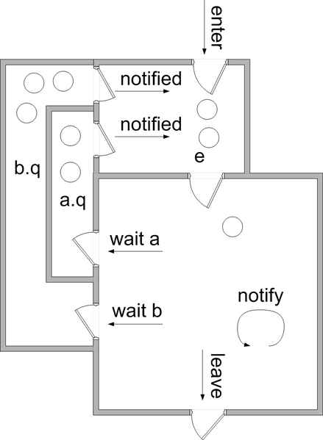
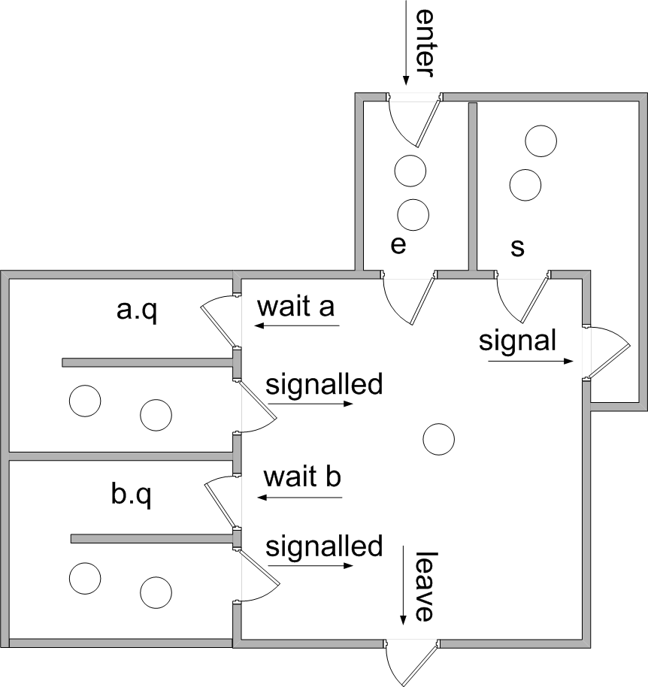
Hoare Style vs Mesa Style
Hoare Style
Mesa Style

Slide 78
Bounded Buffer by Monitor
BoundedBuffer {
int BUFFER[MAX_SIZE];
int head, tail, size;
cond full, empty;
Enqueue (int v) {
while( size == MAX_SIZE)
full.wait();
BUFFER[tail] = v;
tail = (tail+1) % MAX_SIZE;
size++;
if (size ==1) empty.signal();
}
Deque (int v) {
while(size==0)
empty.wait();
int i = head;
head = (head+1) % MAX_SIZE;
size--;
if ( size == MAX_SIZE-1)
full.signal();
return BUFFER[i];
}
…………
}

Slide 79
Monitor Solution to Dining Philosophers
monitor DiningPhilosophers
{
enum { THINKING; HUNGRY, EATING) state [5] ;
condition self [5];
void pickup (int i) {
state[i] = HUNGRY;
test(i);
if (state[i] != EATING) self[i].wait;
}
void putdown (int i) {
state[i] = THINKING;
// test left and right neighbors
test((i + 4) % 5);
test((i + 1) % 5);
}

Slide 80
Solution to Dining Philosophers (Cont.)
void test (int i) {
if ((state[(i + 4) % 5] != EATING) &&
(state[i] == HUNGRY) &&
(state[(i + 1) % 5] != EATING) ) {
state[i] = EATING ;
self[i].signal () ;
}
}
initialization_code() {
for (int i = 0; i < 5; i++)
state[i] = THINKING;
}
}

Slide 81
Solution to Dining Philosophers (Cont.)
Each philosopher i invokes the operations pickup() and putdown() in the following sequence:
DiningPhilosophers.pickup(i);
EAT
DiningPhilosophers.putdown(i);
No deadlock, but starvation is possible

Slide 82
Hoare Style Monitor Implementation (using semaphores)
Need mutual exclusion semaphore mutex (init to 1) so that only one process is active within monitor
Need a semaphore next (next to exit) for the signaling process to suspend itself
  initialized to zero
next_count is number of processes blocked on next
Before exiting a procedure, process must either:
  Signal other waiting processes in monitor next before exiting, or
  Signal mutex and exit

Slide 83
Monitor Implementation (Hoare Style)
The monitor “compiler” has to automatically
insert this code into compiled procedures:
Procedure F:
wait(mutex);
...
body of F
...
if (next_count>0)
signal(next);
else
signal(mutex);
end;

Slide 84
Condition Variable Implementation (Hoare)
Each condition x has a count, and a standard semaphore (with associated queue) initialized to 0
x.wait() {
x.count++;
if (next_count>0)
signal(next);
else
signal(mutex);
wait(x.sem);
x.count--;
}
x.signal() {
if (x.count >0){
next_count++;
signal(x.sem);
wait(next);
next_count--;
}
}

Slide 85
Monitor Implementation (Mesa Style)
Need mutual exclusion semaphore mutex (init to 1) so that only one process is active within monitor
The monitor “compiler” has to automatically insert this code into compiled procedures:
Procedure F:
wait(mutex);
...
body of F
...
signal(mutex);
end;
Chapter 7

Slide 86
Condition Variable Implementation (Mesa)
Each condition x has a count, and a standard semaphore (with associated queue) initialized to 0
x.wait() {
x.count++;
signal(mutex);
wait(x.sem);
wait(mutex);
}
x.signal() {
if (x.count >0){
x.count--;
signal(x.sem);
}
}
Chapter 7

Slide 87
Difference between Monitors and Semaphores
Monitors enforce mutual exclusion
Semaphore wait vs. Monitor wait
  Semaphore wait blocks if value is 0
  Monitor wait always blocks
Semaphore signal vs Monitor signal
  Semaphore signal either wakes up a thread or increments value
  Monitor signal only has effect if a thread waiting
Semaphores have “memory”

Slide 88
Resuming Processes within a Monitor
If several processes queued on condition x, and x.signal() executed, which should be resumed?
FCFS frequently not adequate
conditional-wait construct of the form x.wait(c)
  Where c is priority number
  Process with lowest number (highest priority) is scheduled next

Slide 89
Single Resource allocation
Allocate a single resource among competing processes using priority numbers that specify the maximum time a process plans to use the resource
R.acquire(t);
...
access the resurce;
...
R.release;
Where R is an instance of type ResourceAllocator

Slide 90
A Monitor to Allocate Single Resource
monitor ResourceAllocator
{
boolean busy;
condition x;
void acquire(int time) {
if (busy)
x.wait(time);
busy = TRUE;
}
void release() {
busy = FALSE;
x.signal();
}
initialization code() {
busy = FALSE;
}
}

Slide 91
Synchronization Examples
Solaris
Windows
Linux
Pthreads

Slide 92
Solaris Synchronization
Implements a variety of locks to support multitasking, multithreading (including real-time threads), and multiprocessing
Uses adaptive mutexes for efficiency when protecting data from short code segments
  Starts as a standard semaphore spin-lock
  If lock held, and by a thread running on another CPU, spins
  If lock held by non-run-state thread, block and sleep waiting for signal of lock being released
Uses condition variables
Uses readers-writers locks when longer sections of code need access to data
Uses turnstiles to order the list of threads waiting to acquire either an adaptive mutex or reader-writer lock
  Turnstiles are per-lock-holding-thread, not per-object
Priority-inheritance per-turnstile gives the running thread the highest of the priorities of the threads in its turnstile

Slide 93
Windows Synchronization
Uses interrupt masks to protect access to global resources on uniprocessor systems
Uses spinlocks on multiprocessor systems
  Spinlocking-thread will never be preempted
Also provides dispatcher objects user-land which may act mutexes, semaphores, events, and timers
  Events
    An event acts much like a condition variable
  Timers notify one or more thread when time expired
  Dispatcher objects either signaled-state (object available) or non-signaled state (thread will block)

Slide 94
Linux Synchronization
Linux:
  Prior to kernel Version 2.6, disables interrupts to implement short critical sections
  Version 2.6 and later, fully preemptive
Linux provides:
  Semaphores
  atomic integers
  spinlocks
  reader-writer versions of both
On single-cpu system, spinlocks replaced by enabling and disabling kernel preemption

Slide 95
Pthreads Synchronization
Pthreads API is OS-independent
It provides:
  mutex locks
  condition variable
Non-portable extensions include:
  read-write locks
  spinlocks

Slide 96
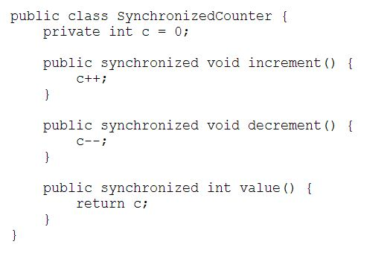
Java-style monitors
Integrated into the class mechanism
  Annotation “synchronized” can be applied to a member function
    This function executes with implicit mutual exclusion
  Wait, Signal, and Broadcast are called monitor wait, notify, and notifyAll, respectively
http://docs.oracle.com/javase/tutorial/essential/concurrency/syncmeth.html

Slide 97
Alternative Approaches
Transactional Memory
OpenMP
Functional Programming Languages

Slide 98
Transactional Memory
A memory transaction is a sequence of read-write operations to memory that are performed atomically.
void update()
{
/* read/write memory */
}

Slide 99
OpenMP
OpenMP is a set of compiler directives and API that support parallel progamming.
void update(int value)
{
#pragma omp critical
{
count += value
}
}
The code contained within the #pragma omp critical directive is treated as a critical section and performed atomically.

Slide 100
Functional Programming Languages
Functional programming languages offer a different paradigm than procedural languages in that they do not maintain state.
Variables are treated as immutable and cannot change state once they have been assigned a value.
There is increasing interest in functional languages such as Erlang and Scala for their approach in handling data races.

Slide 101
End of Chapter 5

